Slide 1
Understanding Health Disparities Activity

Slide 2
Social Class and Health Disparities
Limited Resources
  Lack of access to healthy foods
    More like to live in food deserts, with limited options for healthy foods
  More likely to lead sedentary lifestyles
    Walkability
    Psychosocial stress

Slide 3
Social Class and Health Disparities
Access to health system
  Poor more likely to be uninsured/underinsured
  Less likely to get screened/treated
  Less likely to afford needed treatment

Slide 4
Social Class and Health Disparities
Greater exposure to risks…
  Physical (poor sanitation, poor housing)
  Chemical (pollution)
  Biological (bacteria, viruses)

Slide 5
500 Cities Website

Slide 6
Poverty Status, Employment, Education, and Health Coverage
 | North Dallas (zip:75093) | South Dallas (zip:75241)
Percent in Poverty | 5.5% | 26.3%
Percent Unemployed | 5.1% | 10.4%
Percent with BA | 23% | 6.3%
Percent Uninsured | 5.2% | 20.1%
Data from US Census: https://data.census.gov/cedsci/

Slide 7
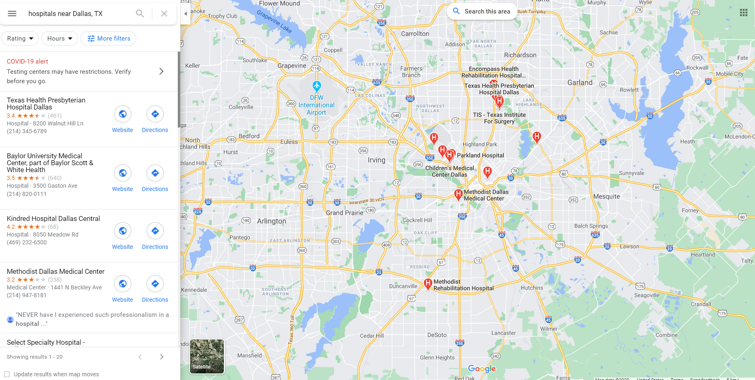
Google Maps Screenshot

