Slide 1
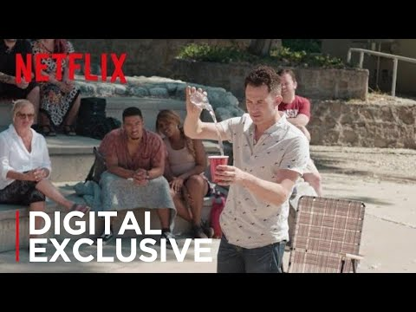
Intro- Watch this clip from “Magic for Humans” then discuss the following questions
Did the 2 people in the trick “actually” disappear?
What factors (2-3 specific examples) made the 2 people in the trick think that they were invisible?
Could these two people describe what it would be like to be made invisible for a few minutes?
Imagine that the person actually WAS made invisible. How similar/different do you think their experience would be?

Slide 2
Social Construction of Reality
Objectives: Students will be able to…
Define the “social construction of reality.”
Assess the impact of social context and social interactions on human behavior and beliefs in a specific example.
Use the “sociological imagination” to assess how their own experiences have been impacted by the “social construction of reality.”

Slide 3
Social Construction of Reality
Watermelon example:
Why did the vendor and the author have different beliefs about whether or not it was a good idea to eat the watermelon?
Notes:
Instructor Notes:
Provide a definition and brief explanation of the social construction of reality. To illustrate, read the following vignette from Henslin 2012.
On a visit to Morrocco in Northern Africa, I decided to buy a watermelon. When I indicated to the street vendor that the knife he was going to use to cut the watermelon was dirty (encrusted with filth would be more apt), he was very obliging. He immediately bent down and began to swish the knife in a puddle on the street. I shuddered as I looked at the passing burros that were urinating and defecating as they went by. Quickly, I indicated by gesture that I preferred my melon uncut after all.
Answer: For that vendor of watermelons, germs did not exist. For the author, they did. And each of us acts according to our definition of the situation.

Slide 4
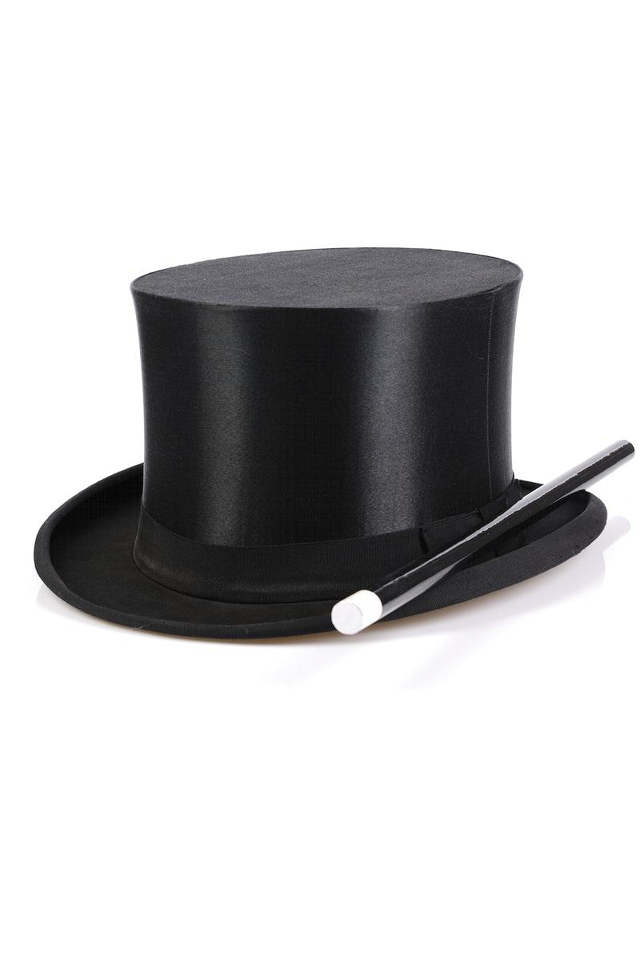
Check for understanding:
Use the phrase “social construction” or “socially construct” to answer the question below:
Why did the participants in the video at the beginning of class think that they had been made invisible?

Slide 5
Application Assignment
Can you think of other experiences you have had or common ideas in our society that are socially constructed? Pick one of these and write a paragraph that answers the following prompts:
Create a short topic sentence that identifies the experience, belief, or social concept that you will analyze.
If you need help- children often believe in imaginary characters associated with different holidays or events that seem real to them at the time; there are certain objects/concepts in society that we view as important symbols and treat with special rules or expectations.
Write a short sentence defining the concept “social construction of reality.”
Write at least 2-3 sentences explaining: how certain social interactions or contexts act to create an experience or teach a set of beliefs about the topic you chose.
Think about- What makes this experience or thing seem real/different? Why would someone from a totally different culture not have the same beliefs or understanding about the topic as you do?
Conclude your paragraph with 1-2 sentences explaining how the topic you chose shows the “social construction of reality.”

Slide 6
Optional Extended Learning Activity:
Students will choose a famous experiment to research from the list on the right.
Be prepared to discuss/present/write about the following:
Summarize what took place in the study (who, what, when, where, why).
Describe what social behaviors or other factors helped create an experience that seemed “real” for participants.
How was the behavior of the participants impacted by their own belief that the situation they were in was reality?
In your opinion, why is it important to know about this case study and how can it help us understand other things in society?
What are some ethical problems with the case study you chose?
Famous Experiments (each link is a 15-25 minute video for students to watch):
Philip Zimbardo’s “Stanford Prison Experiment.”
Jane Elliot’s “Brown eyes vs blue eyes” activity.
Stanley Milgram’s “Obedience Study”

