Slide 1

Introduction to Research Methods in Sociology

Slide 2
Contents
Lesson plan for college level or high school
Lesson plan time: 1or 2 50-minute class periods
Learning Activities: Content Analysis Exercise, Survey Activity, and Class Discussion
Measurable Outcomes: Mapping Research Methods to Research Questions (Homework Assignment)
Notes:
Added this

Slide 3

What is Sociology?
Notes:
Introduce the study of sociology to students. If teaching an intro to sociology course, then skip this discussion or if already reviewed by the instructor.
Ask students what they the think sociology is
Sociology is the study of the social world around us

Slide 4
Overview of Key Terms
Sociology
Surveys
Interviews
Experiments
Observations
Content Analysis
Notes:
Introduce the key terms and concepts you want students to learn/take away from the lesson

Slide 5
Research Methods in Sociology
Sociologists investigate critical questions about poverty, social inequality, discrimination, gender, among others
Sociologists use different methods to study the social world and gather information about society
Notes:
The diversity of social problems demands the use of different research methods

Slide 6
Learning Objectives
Students will learn the primary methods used in sociological research
Students will better understand how sociologists study the social world around them
Students will analyze surveys and content analysis

Slide 7
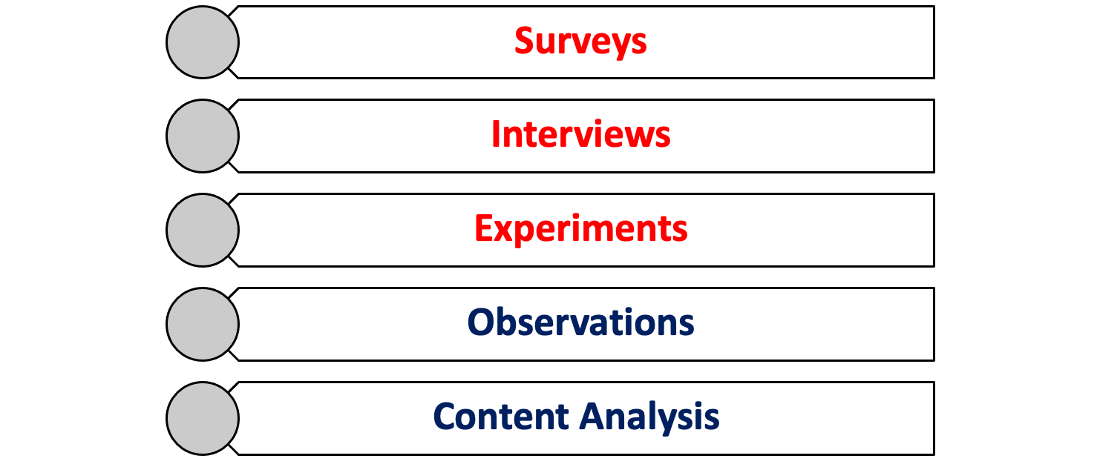
CORE METHODS OF SOCIOLOGICAL RESEARCH
Notes:
Briefly discuss each one, but mention how the focus will be surveys and content analysis

Slide 8
Interviews
Structured interview: The interviewer asks the different participants the same set of questions, usually from prewritten and structured questionnaires.
•Unstructured interview: It involves the interviewer asking the different participants questions according to the response they receive. There is the freedom to ask questions that are found to be appropriate in the conversation.
Semi-structured interview: The interviewer has a list of questions, but the interviewee is free to discuss any topic or share what they feel is most appropriate.
Group interview: It involves the interviewer interviewing two or more participants at the same time.
Have some form of interview guide (questions that guide your study).

Slide 9
Experiments
Brief overview of experiments

Slide 10
Observations
Brief overview of observations

Slide 11


Surveys
Many social scientists rely on surveys as their primary method of data collection (Chambliss & Schutt 150).
A sample survey question: What are you most afraid of?

Slide 12
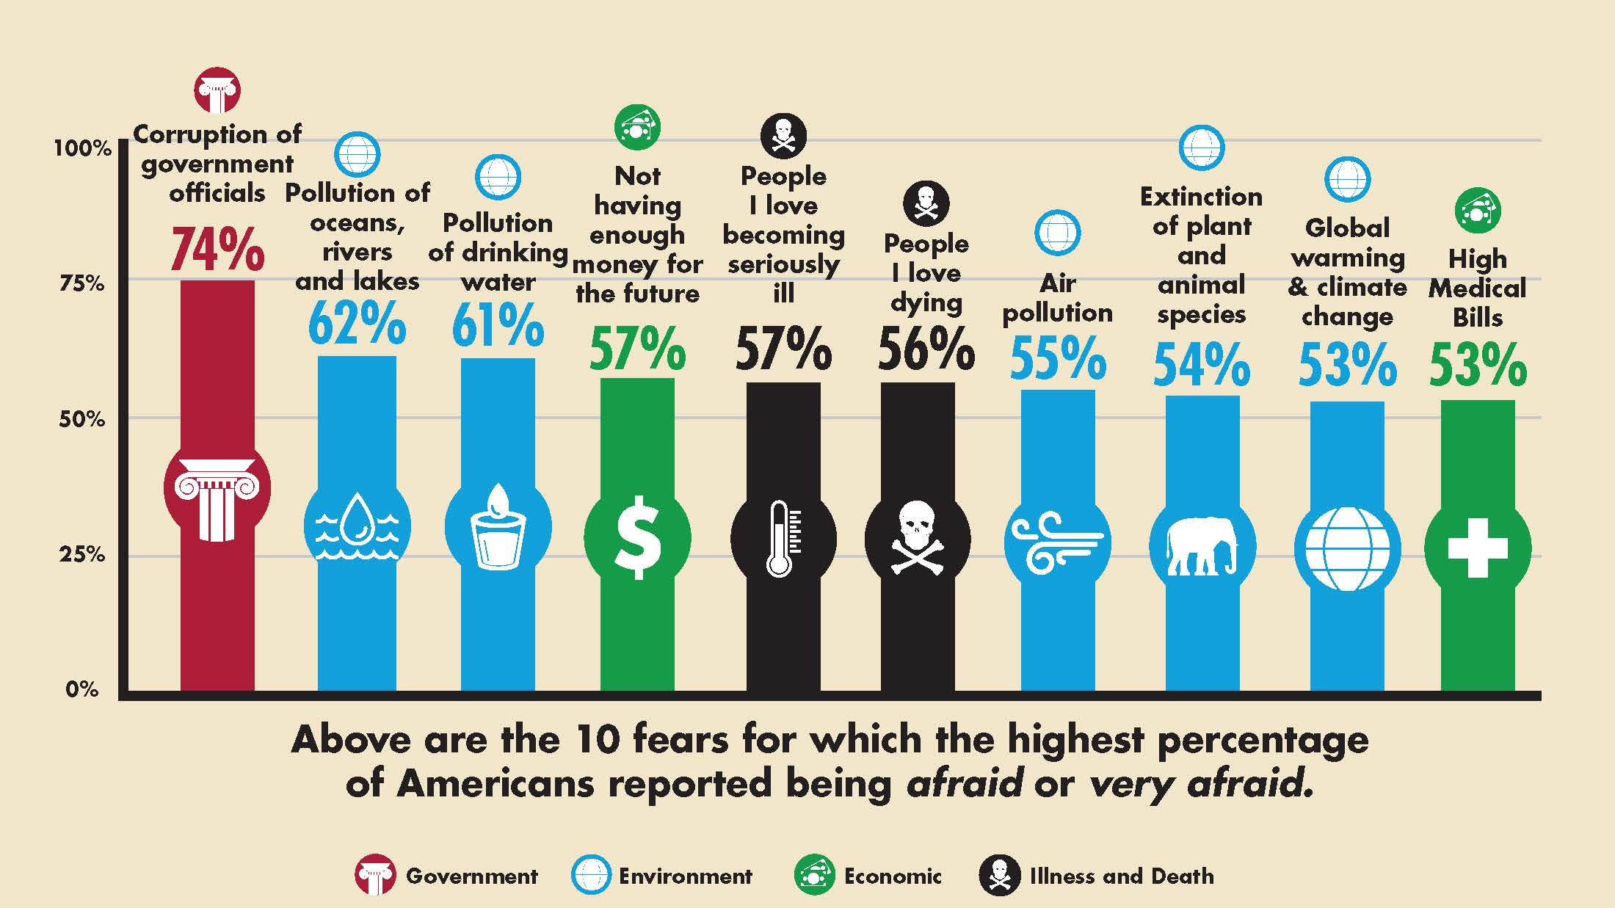
Survey asking people what they are most afraid of

Slide 13

What is a Survey?
Survey research collects information from a sample of individuals by asking standardized questions (same questions for every person)
Collects data about people and their preferences, thoughts and behaviors in a systematic manner

Slide 14
What is a survey?
In general, surveying individual people
Researchers use information from a sample to make inferences about the wider population
  For example, surveying high school students about their favorite social media (we would sample a population of the students, not the entire school).

Slide 15
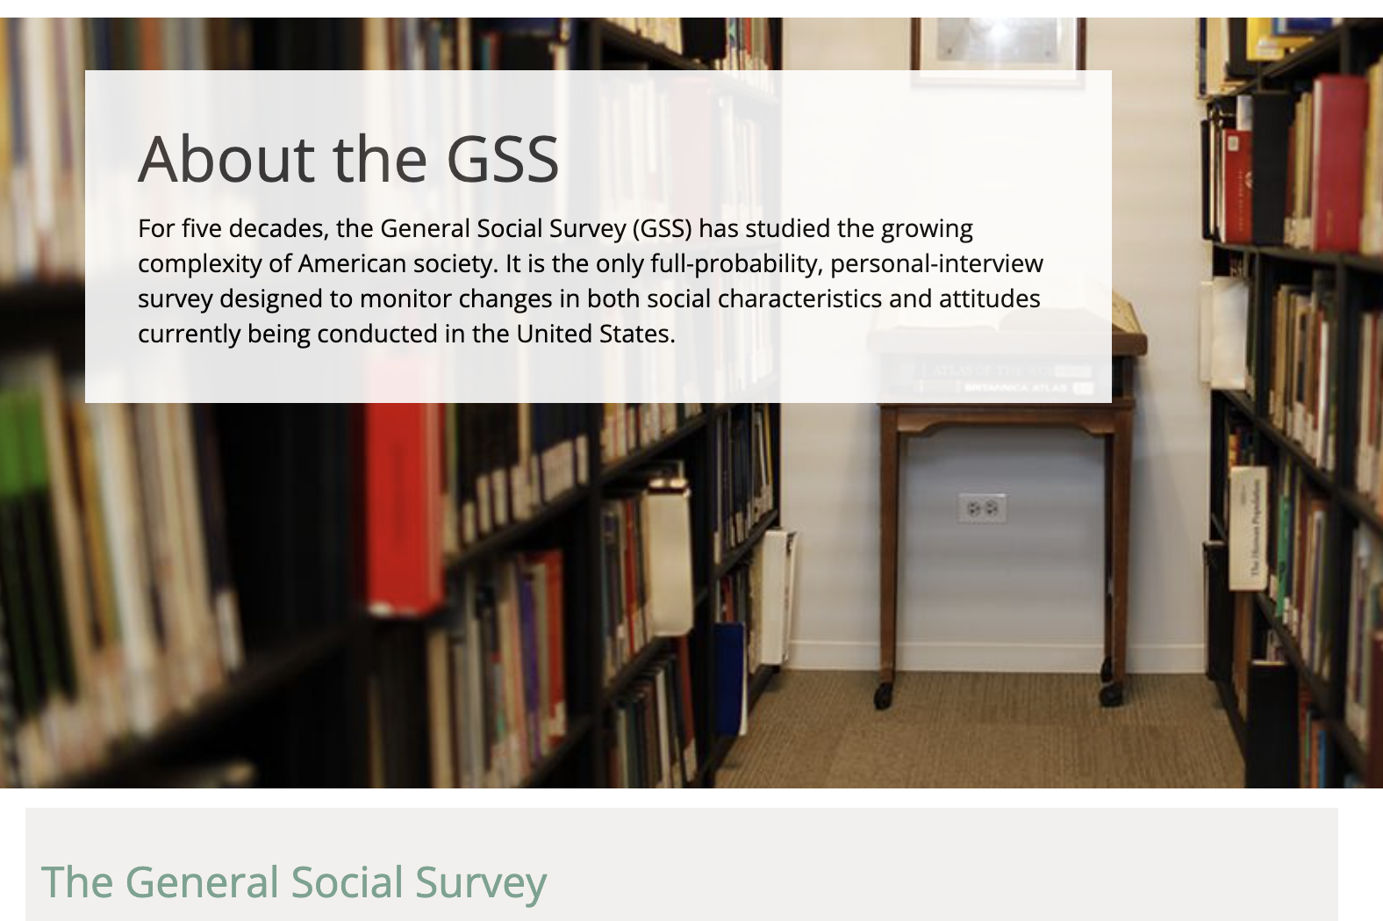
https://gssdataexplorer.norc.org/variables/vfilter
Notes:
GSS used by many sociologists. Can take students to the website and show them what data is collected (race, gender, etc..)
https://gssdataexplorer.norc.org/variables/vfilter (follow the link it lists the key variables in GSS and you can search variables you are interested in)—This can be another in-class activity

Slide 16
Advantages Of Surveys
Can be used to measure a wide variety of unobservable data, such as people's political orientation), traits, attitudes ,beliefs (e.g., about a new law), behaviors (e.g., smoking or drinking)
Ideal for collecting data about a population that is too large to observe directly. Such as an entire country
Efficient because its more cost effective and can collect data rapidly
Notes:
Also information on income
We see surveys being collected on political opinions, products, survey about your experience in a store, people's happiness,
Also information on income
We see surveys being collected on political opinions, products, survey about your experience in a store, people's happiness,
1. Can be used to measure a wide variety of unobservable data, such as people's political orientation), traits, attitudes (e.g., towards specific social groups),beliefs (e.g. about a new law), behaviors (e.g. smoking or drinking)
2. for instance it will be difficult to survey an entire country

Slide 17
Advantages of Surveys
4. allows for comparative analysis between and within groups
5. versatility: used for various type of studies including public opinion polls, election campaigns, program evaluations, and community needs assessment (which makes research meaningful and gives the ability to impact communities)

Slide 18
RESEARCH THAT MATTERS
We can use surveys for community research and needs assessment.
we can use surveys to find out what are some of the largest problems facing communities
centering the voice and experiences of the community
We can survey different neighborhoods across the city and see if the most pressings issues include: Access to Healthcare; Need for Parks; Safety; or Education. We conduct the survey and develop a report or proposal for the city council, the school district, or the County's health department
We can also publish the results in academic journal about urban inequality

Slide 19
Writing survey questions
Clarity: are questions understood by respondents?
Level of wording (simple, straight forward, and to the point)
Avoid highly technical language
Notes:
Questions are the central part of survey research, so selecting good questions is the most important concern for researchers
Questions have to be clear and convey the intended meaning to your respondents

Slide 20
Tools for Administering Surveys
Mailed survey
Phone survey
In person survey
Email/ Online Survey
  Can use platforms like SurveyMonkey (free) or Qualtrics
  Class Question: Which one do you think is the most effective to use?

Slide 21
Examples of survey questions
How can we make good survey questions?

Slide 22
Question 1
What issue do you feel is most impacting society?
A. Healthcare
B. employment
C. Education
D. None
How can we transform this question into a more precise survey question?
Which issue do you feel is the number one problem negatively affecting your neighborhood today?
A. Healthcare
B. Employment
C. Education
D. Parks
E. Safety
F. Other.__________
Notes:
explain the difference, why the second question is superior, it is less vague and more specific in terms of scope (your community), time (today/now/contemporary period, etc.) and negative versus positive

Slide 23
Question 2
Residential location:___________________
How can we make this question a more precise survey question? Does it ask for town? Country? Street address?
Better question: In what city or town do you live?
Even better: What is your zip code?
Notes:
This focuses attention clearly on a specific geographical unit
This focuses attention clearly on a specific geographical unit, -too specific may risk anonymity, especially address. You may want to just say this

Slide 24
Homework Assignment
Create your own survey (5 questions minimum)
What topic or issue do you care about? What would you like to know?
What are five questions you would ask of your participants?
What tool/platform would you use to administer your survey and why? (e.g., by Phone, Mail, internet, etc.)
Notes:
Print the homework assignment and discuss with students before end of class

Slide 25




Content Analysis
A research method that sociologists use to examine words or phrases within a wide range of texts
analysis of any form of communication
can analyze tweets from Twitter, songs, tv shows, books, essays, cartoons, political speeches

Slide 26

Content Analysis Activity
Get into groups of 3-4 students
Each student selects the first five pictures on their phone (appropriate for school and peer sharing)
What are common themes or patterns you observe among the pictures of your group?
List the people, objects, and activities you see

Slide 27
Conclusion
Sociologists use diverse methods to answer important research questions about the social world around us
Qualitative and quantitative methods: Content analysis, surveys, interviews, experiments, and observations are used by sociologists
Using the appropriate research method social scientists can make meaningful investigations that can make an impact in our local communities
Surveys are the most widely used research method by social scientists
Notes:
the importance of surveys

Slide 28
Assessment: Mapping research questions
Notes:
Create a list of questions that students can map to different research methods (surveys and contents analysis focus)

