Slide 1
Flash Data Collection and Analysis
Joanna S. Hunter, Ph.D.
Radford University

Slide 2
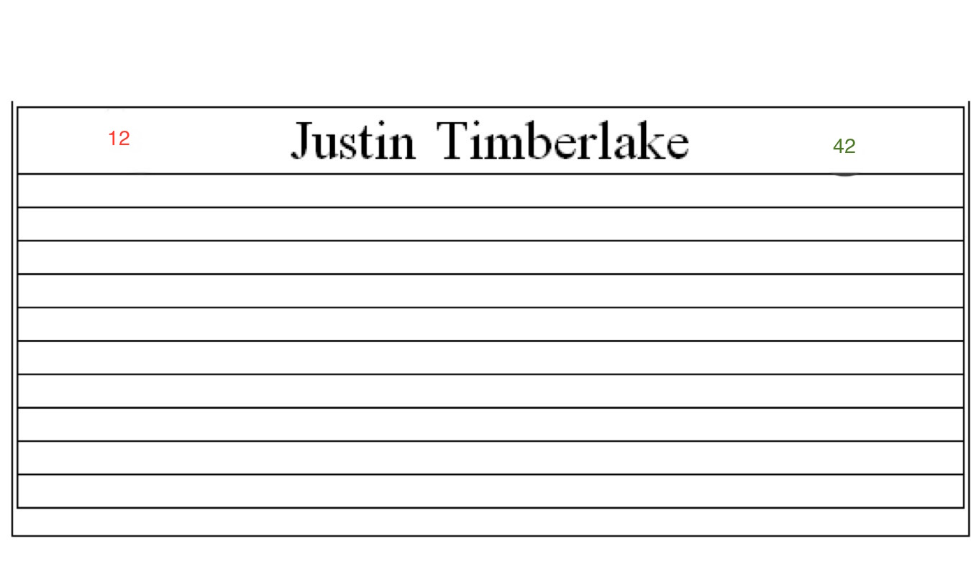
Preparation
Respondent Card

Slide 3
Respondent Card
Name
Date of Birth |  | Group Affiliation
Place of Birth |  | Height
Place of HS Graduation |  | College Major
Race |  | Favorite Color
Gender |  | Shoe Size
I have supplied the name. You must fill in the rest of the information.

Slide 4
Phase One
If the RED number on the card you are holding is 45 OR HIGHER, You are collecting data in Phase One. If the RED number on the card you are holding is 44 OR LOWER, you are a respondent in Phase One.
NAME
Date of Birth | 09/08/1990 | Group Membership | 4H
Place of Birth | Newport News, VA | Height | 5’8”
Place of HS Graduation | Welch, WV | College Major | Sociology
Race | White | Favorite Color | Orange
Gender | Female | Shoe Size | 9.5

Slide 5
Phase Two
If the GREEN number on the card you are holding is 45 OR HIGHER, You are collecting data in Phase Two. If the GREEN number on the card you are holding is 44 OR LOWER, you are a respondent in Phase Two.
NAME
Date of Birth | 09/08/1990 | Group Membership | 4H
Place of Birth | Newport News, VA | Height | 5’8”
Place of HS Graduation | Welch, WV | College Major | Sociology
Race | White | Favorite Color | Orange
Gender | Female | Shoe Size | 9.5

Slide 6
Phase Three
Based only on the data you collected in your interview, rank the following statements on a scale of 1 to 5 where one is less likely and 5 is most likely. Record your responses on the reverse of your card.
Your respondent will vote in the next presidential primary.
Your respondent will have more than two children before they are 30 years old.
Your respondent will drink alcohol in the next 72 hours.
Your respondent will earn an A in this class.
Your respondent will conceive an invention that will change the world.

Slide 7
Variables and Attributes
Date of Birth
  Month, day, year
  Interval
Place of Birth
  Location
  Nominal
Place of HS Graduation
  Location
  Nominal
Race
  White, African American, Asian, etc.
  Nominal
Gender
  Male, Female, etc.
  Nominal
Group Membership
  Organizations
  Nominal
Height
  Feet and Inches
  Ratio
Major
  Sociology, Marketing, etc.
  Nominal
Favorite Color
  Orange, Blue, Red, etc
  Nominal
Shoe Size
  5 1/2
  Ratio

Slide 8
Drawing Inferences
Independent and Dependent Variables
Independent Variable
(Cause)
Dependent Variable
(Effect)
College Major
Likelihood of Voting

