Slide 1
Introduction to Sociology
Danish Baby Carriage on the Curb
Created by Hayley Lotspeich and Kyla Walters

Slide 2

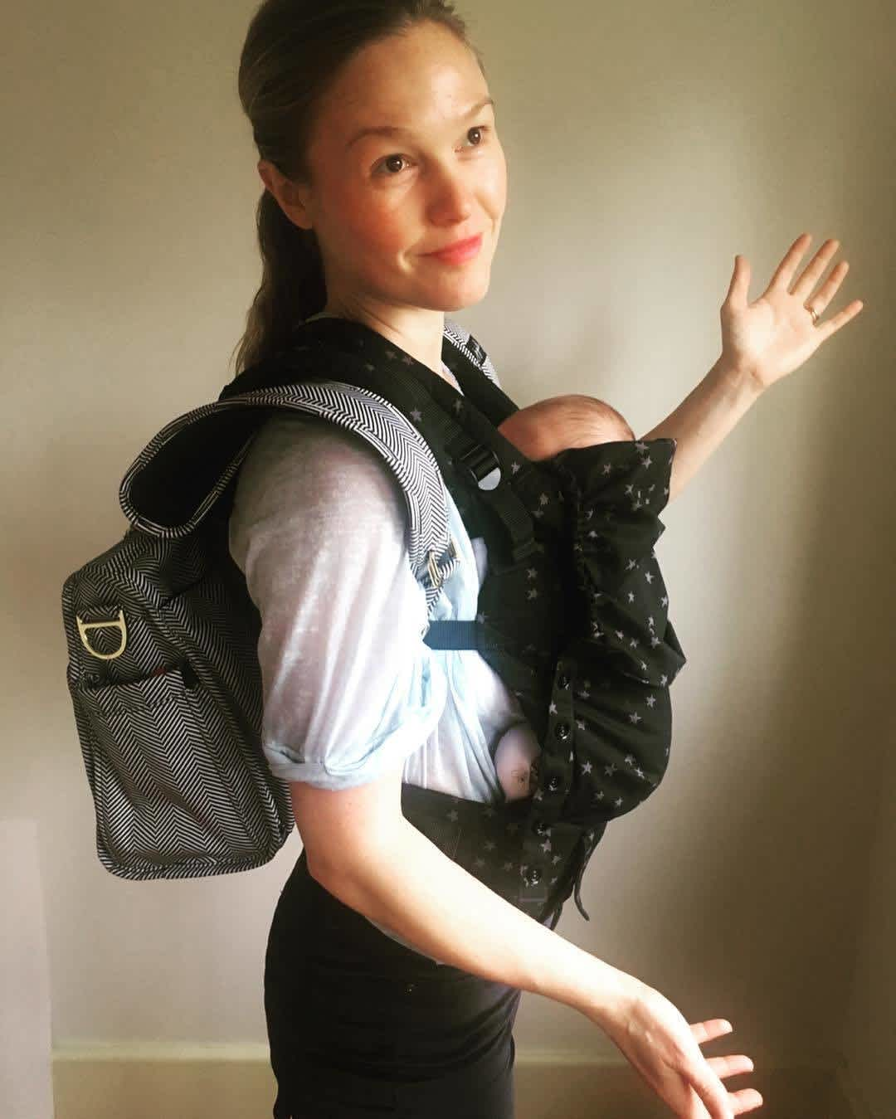

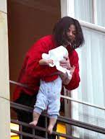
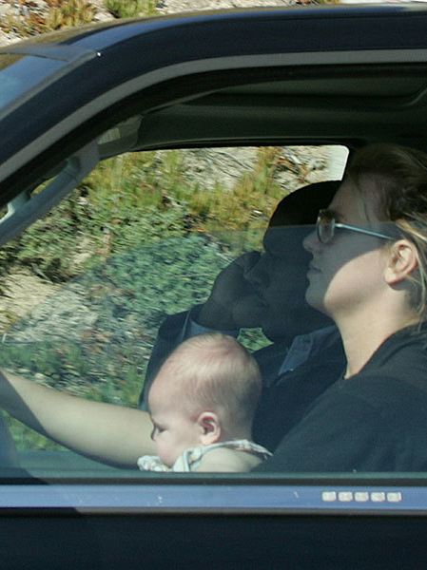

Are any of these bad parents?
Why or why not?
Celebrity parents, from left to right: Julia Stiles, Charlie Sheen, Michael Jackson, Chrissy Teigen, Britney Spears, and Woody Allen.
Notes:
Note the goal of this slide to the students. (Try to avoid “what makes a good mom” at this point in the lesson because it will derail the lesson.)

Slide 3

Guiding Questions for Today’s Lesson
What do you think of someone who leaves their baby unattended in its stroller on the sidewalk … and during cold winter weather?
Is this an example of acceptable or unacceptable parenthood?
Why? How do you know?

Slide 4
One Time in New York City
Annette Sorensen, an actress from Copenhagen, Denmark, and her American husband dined inside a restaurant on a chilly Manhattan day.
They left their 14-month-old daughter outside in a stroller during the meal.
Many passersby, who noted the baby was cold and crying, called the police.
NYC authorities removed the child from her parents, temporarily placing her in foster care. The parents were arrested and spent two nights in jail.

Slide 5
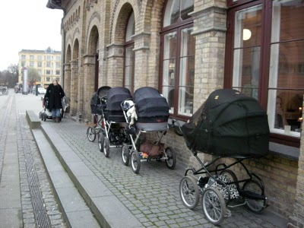
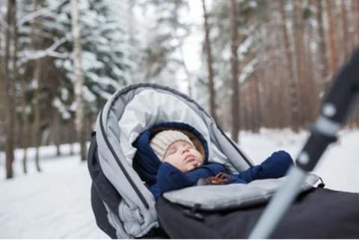
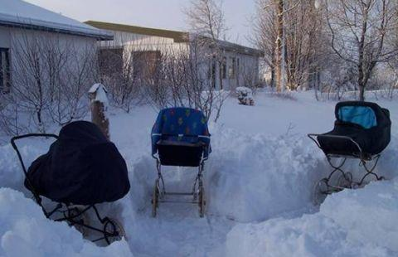
Commentary
(from Kallick Dyssegaard in New York Times)
One Danish commentator observed that leaving a baby outside of a restaurant is a very common practice in Denmark. The commentator wrote, “Often, Danish parents….leave their babies outside. For one thing, Danish baby carriages are enormous. Babies ride high above the world on horse-carriage-size wheels. It’s hard to get such a carriage in a café….Besides, Danish cafes are very smoky places.”

Slide 6
Commentary Continued
(from Kallick Dyssegaard in New York Times)
The commentator continued, “In Denmark, people have an almost religious conviction that fresh air, preferably cold air, is good for children. All Danish babies nap outside, even in freezing weather—tucked warmly under their plump goose-down comforters….In Denmark all children own a sort of polar survival suit that they wear from October to April, and they go out every day, even in winter.”

Slide 7
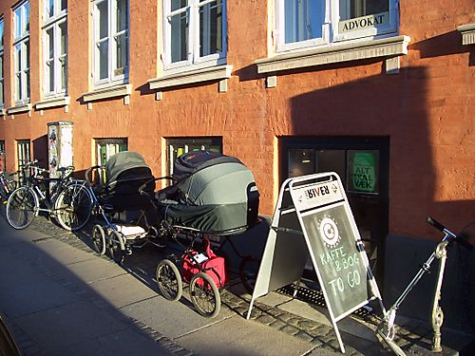

Slide 8
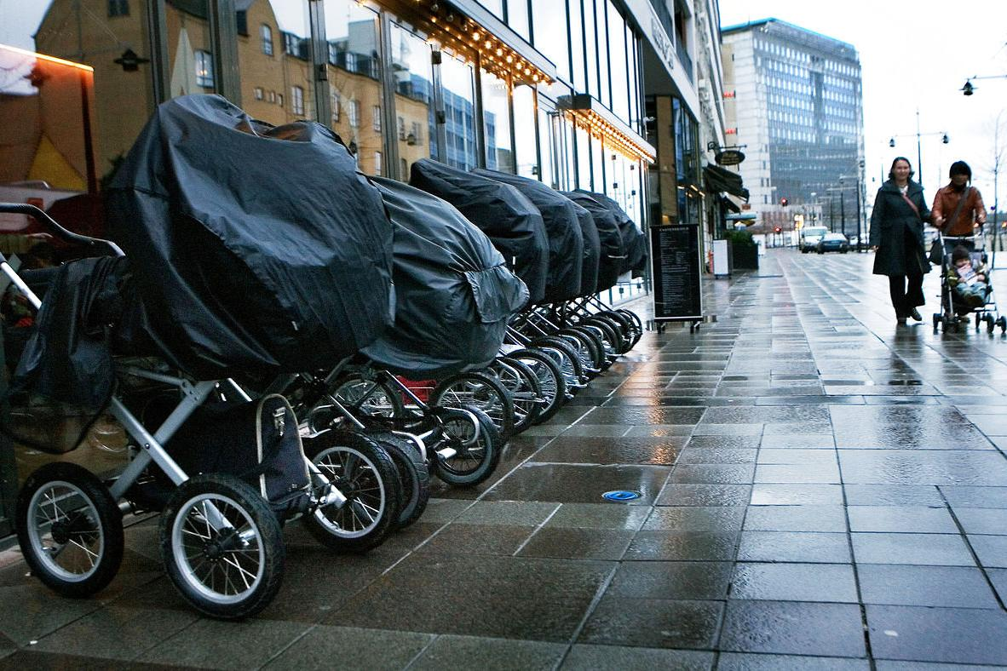

Slide 9
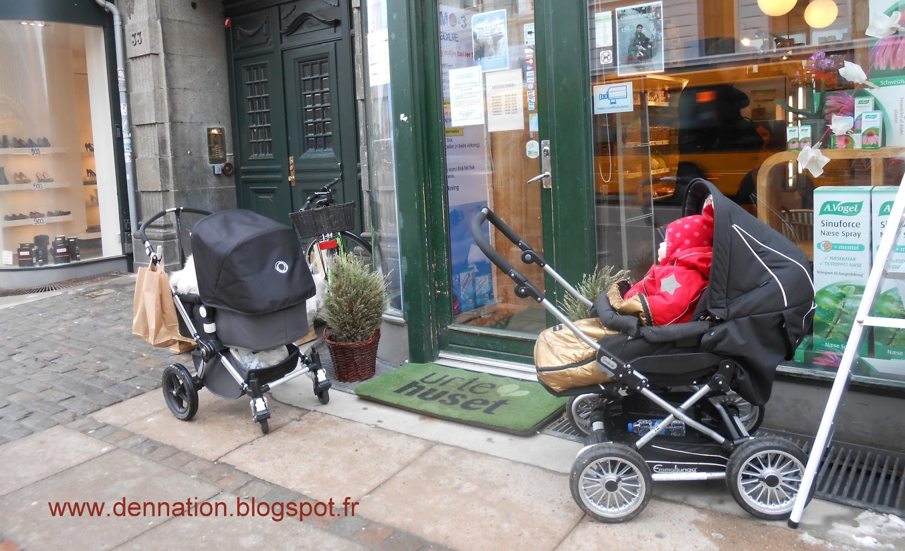
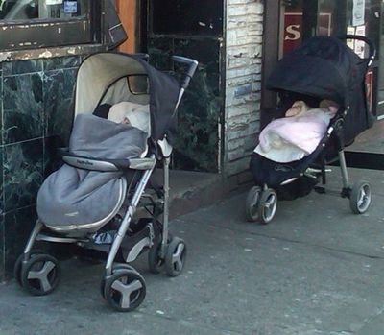

Slide 10
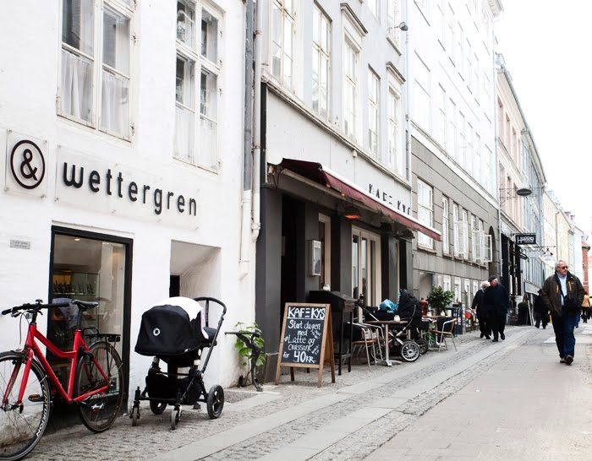

Slide 11
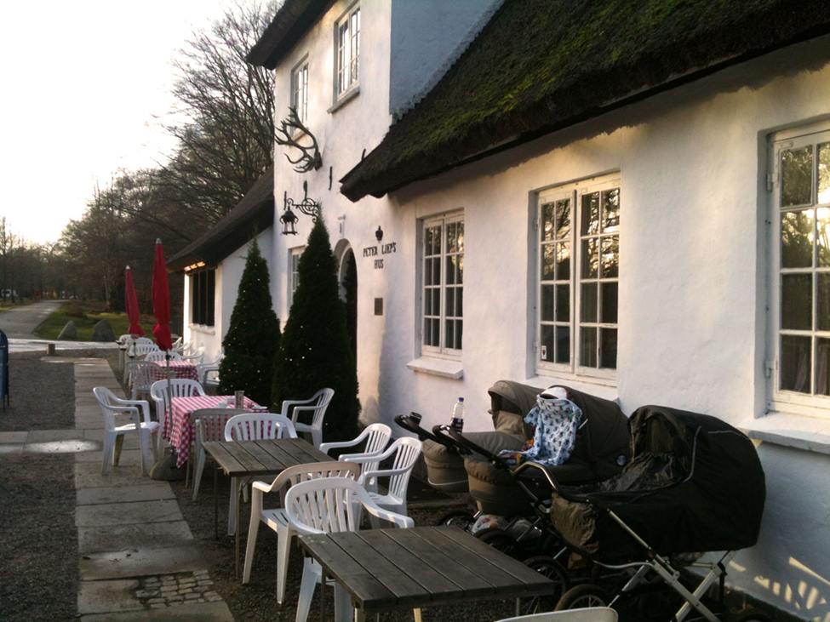

Slide 12
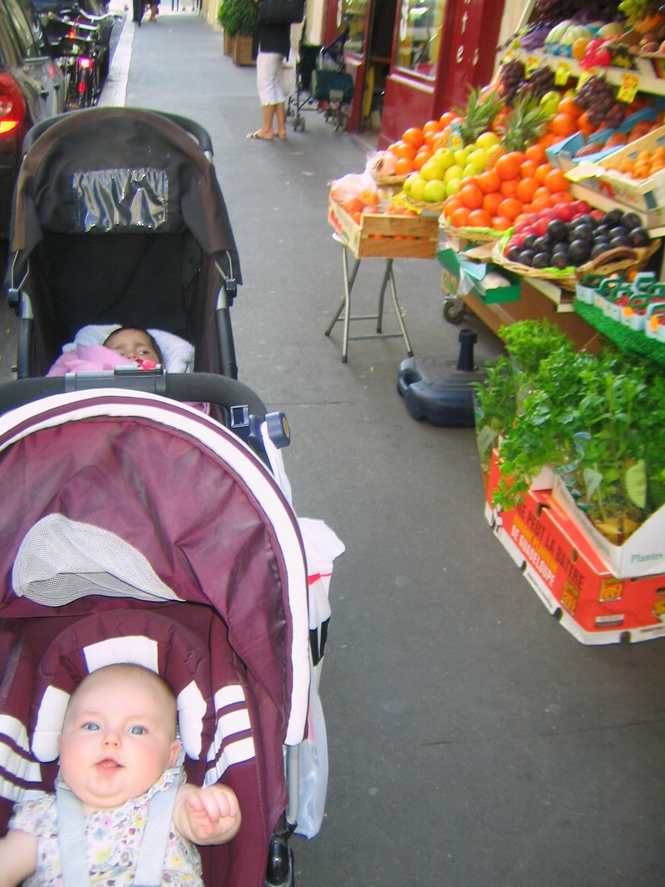
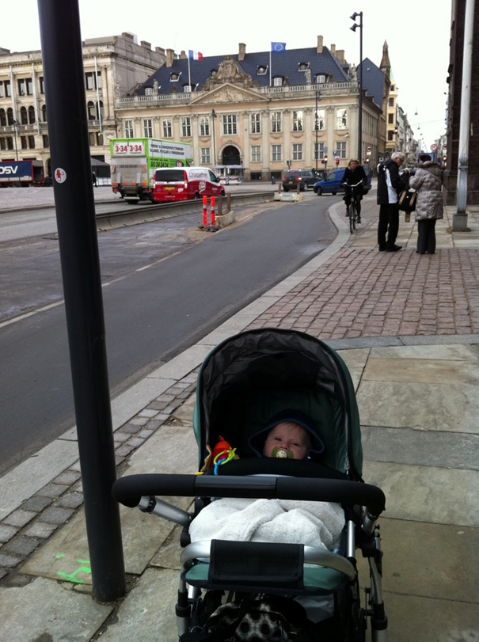

Slide 13
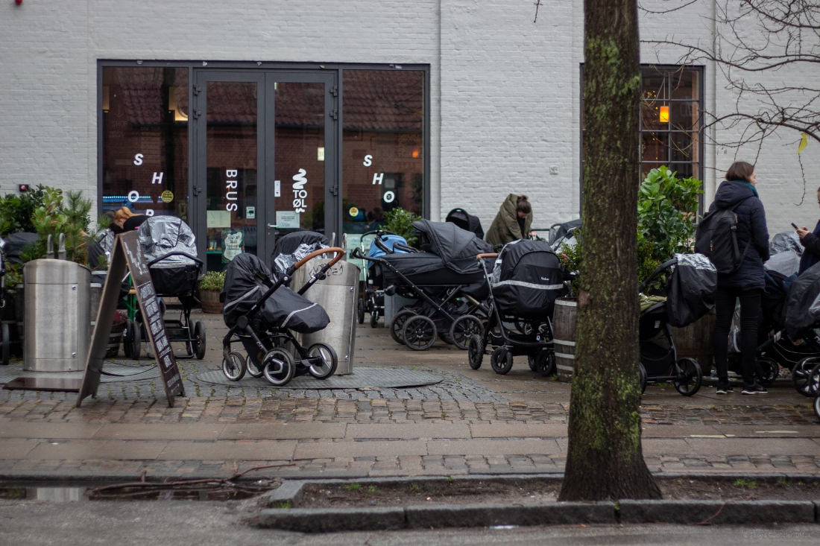

Slide 14
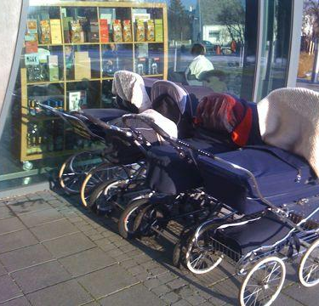
No bad weather, only bad clothing.
The key idea here is that everyone needs plenty of time outside, in any weather. Thus, sleeping in the cold is just fine.
In Scandinavia and Iceland, strollers are built to withstand the elements. There, parents wheel babies around in all types of weather. They also leave them outside at home, or while out and about at cafés, to take a nap inside the pram.
Of course, the babies are well bundled, and the strollers are weatherized, too.

Slide 15
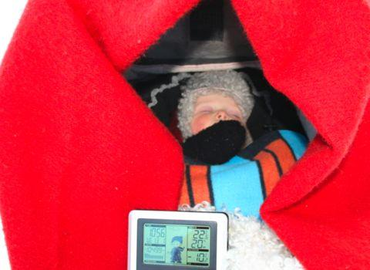
Play: “Why Newborn babies in Sweden…” and “Some facts about babies in Finland”

Slide 16
Ethnocentrism
“the dual judgment that cultural patterns and practices of one’s own society are ‘normal’ and ‘natural’ and that other societies—because they are different—are necessarily ‘abnormal’ and therefore inferior”
(Schopmeyer and Fisher 1993:148)
Notes:
which can negatively affect those who are perceived as outsiders

Slide 17
Cultural Relativity
Approach that evaluates a culture from an insider’s perspective or by its own internal understanding
Notes:
which can negatively affect those who are perceived as outsiders

Slide 18
Cultural Discontinuity
The disconnection or lack of alignment between two cultures
Notes:
which can negatively affect those who are perceived as outsiders

Slide 19
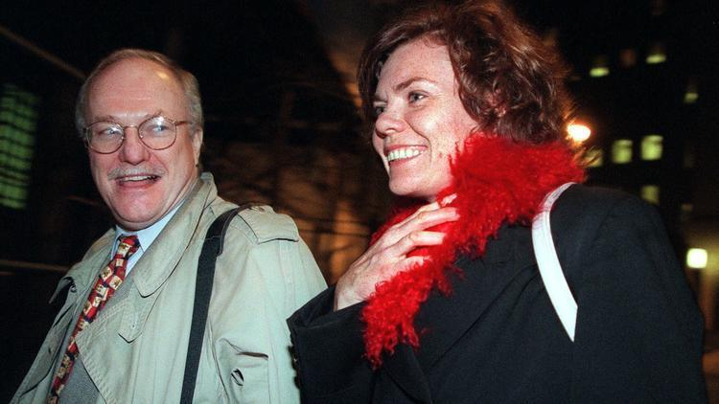
About that
One Time in New York City
Two nights in jail
Lost custody of daughter for over four days
Multiple court appearances and interactions with Child Protective Services
Image Source: https://www.chicagotribune.com/nation-world/ct-anette-sorensen-new-york-baby-20171126-story.html

