Slide 1
Culture
[DATE]
[Course Name/Number]
“Drag is there to remind culture not to take itself too seriously. All of this is illusion.” RuPaul
Notes:
Begin by introducing the overall topic for discussion, and follow it up with a quote that gets students relaxed, but also is engaging and relevant. This should get students Intrigued, and not be too sophisticated.

Slide 2
Where we’ve been…
Last Time:
Next Time:
Notes:
It’s always a good idea to nestle new topics within a larger scheme, and provide students with a road map of where we’ve been, and where we’re going. If this does not suit your own teaching style, be sure to skip this slide, or delete it.
For example, for my class - “Last Time in class we discussed Roles and Status, and the Presentation of Self. These concepts are critical as we move forward, and if anyone needs a refresher on key concepts and terms, be sure to revisit Chapter 4 in your textbook. We will be adjusting how we look at society by moving beyond these broader categories of our individual roles and status in society, and imagining ourselves through others, to begin building a sense of what it is that groups share which structures their social interaction, position, and sense of self.
“As we explore this topic though, keep in mind where we’re going in the next class. We’ll move beyond Culture next time, and discuss the importance and relevance of socialization, which is Chapter 5 in your textbook. Be sure to read ahead of time, and review today’s lecture before Wednesday’s class. We’ll have our third group activity on Friday. Further out, keep in mind that Exam 1 will be one week from this coming Friday.”

Slide 3
Culture
Essential Questions:
In what way(s) does culture allow us to more critically understand the behavior and dynamics of groups?
How does the Sociological Imagination help us to better understand culture?
Notes:
“So again, keeping in mind of where we’re going, which is toward understanding ‘Socialization’, begin applying today’s material to two Essential Questions:
a. In what way(s) does culture allow us to more critically understand the behavior and dynamics of groups?
b. How does the Sociological Imagination help us to better understand culture?
“Everyone should write these down, and continue to return to these two questions throughout the week.”

Slide 4
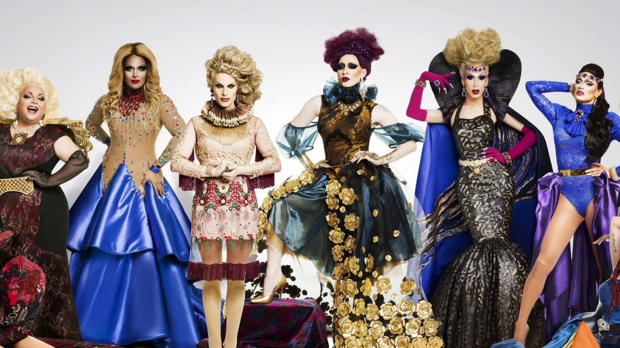
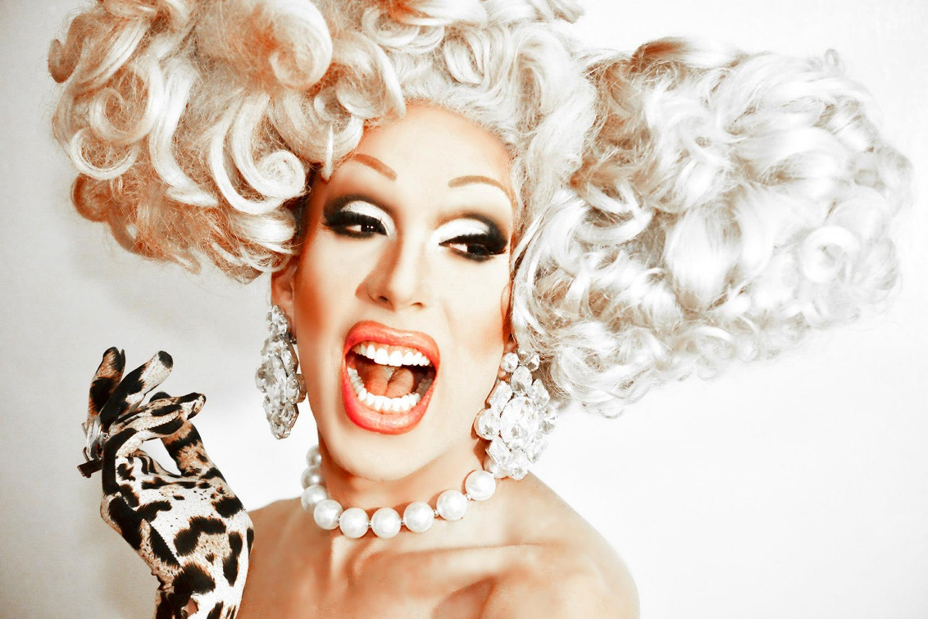
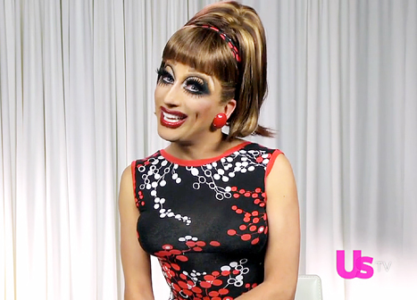
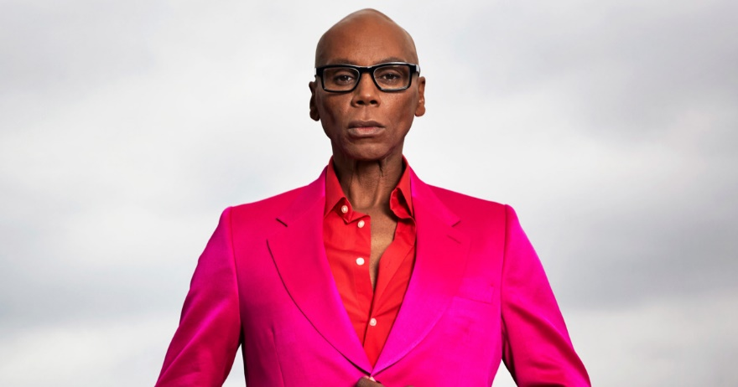
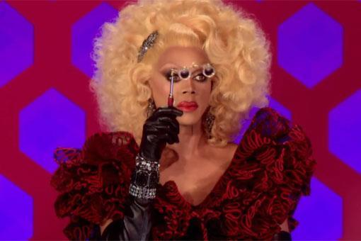
“Drag is there to remind culture not to take itself too seriously. All of this is illusion.” RuPaul
Notes:
“So let’s return to the quote that I showed you at the beginning of this class.”
“Drag is there to remind culture not to take itself too seriously. All of this is illusion.” RuPaul
“Who is RuPaul?”
Start by revealing to students the first image, which is then juxtaposed with the second image.
“This is RuPaul. And this is also RuPaul.”
Then display the rest of the images and engage students in a discussion of how the quote relates to the images below.
Conclude with something along the lines of –
“Drag is about taking elements of gender and accentuating them, or combining them, to the point of ridiculousness. There are two aspects to culture- Ideal, and Real. Ideal culture is that abstract standard that society would ever hope to live up to. Real culture is like it sounds- real – it is the culture that we are steeped and live in everyday. Drag attempts to conflate and mix these two concepts by creatively producing an extreme version of the real, out of ideal concepts of gender: whether it be hair, fashion, masculinity, femininity, or even where gender ends, and biological sex begins. What’s most important about these images though and this quote, is that we should recognize that culture is an incredibly flexible, and malleable concept. And today we’re going to bring this outlandish and abstract concept of culture, down to the everyday. “

Slide 5
Culture
Your Textbook:
Our Definition:
“Behavior based on learned customs is not a bad thing. Being familiar with unwritten rules helps people feel secure and “normal”. Most people want to live their daily lives confident that their behaviors will not be challenged or disrupted.” (OpenStax.org/sociology2e)
What does culture look like?
Where does culture exist?
How does culture change?
Notes:
“So what is Culture?”
Begin by reading aloud the role of culture, and why it exists:
“Behavior based on learned customs is not a bad thing. Being familiar with unwritten rules helps people feel secure and “normal”. Most people want to live their daily lives confident that their behaviors will not be challenged or disrupted.” (OpenStax.org/sociology2e)
Follow-up with a discussion around 3 facets:
What does culture look like?
Where does culture exist?
How does culture change?
The accuracy of the answers shouldn’t be immediately assessed (it would be pretty difficult to address them at this point anyways). Instead, let students respond, and encourage them to develop some of those ideas beyond ‘culture is everything’ or ‘culture is found everywhere’. The goal should be to get students to think more tangibly about culture to facilitate the exercise which follows.

Slide 6

Culture Through Objects
What is the object I’ve handed out?
How would you describe it in detail?
What would you call it?
Notes:
Hand out the a can/bottle of Coca-Cola. If you have a medium sized class (40-60) students then you may want to bring two cans/bottles and hand one at the front and one at the back for students to pass around. Wait 15-30 seconds so that everyone is at least aware of what is being passed around before asking the most basic question:
a. “What is the object I’ve handed out?”
b. Students usually supply an answer quickly.
Follow-up with:
“How might you describe this object in detail?”
Encourage students to move beyond the shape, and color of the object. If students struggle with this part, ask “What is it made of?” The goal here is to move beyond the superficial presentation of the object, and begin discussing what’s involved in its production, who the stakeholders are, and who’s affected by its production. This is explored more in depth later on in the lecture (Slide 9 and 10)
Follow discussion with:
a. “What would you call it?” If the answer isn’t forthcoming, ask students “What names might we call it?” After identifying the three most popular names for carbonated beverages (Pop, Soda, and Coke – in no particular order of course…), move on to Slide 7.

Slide 7
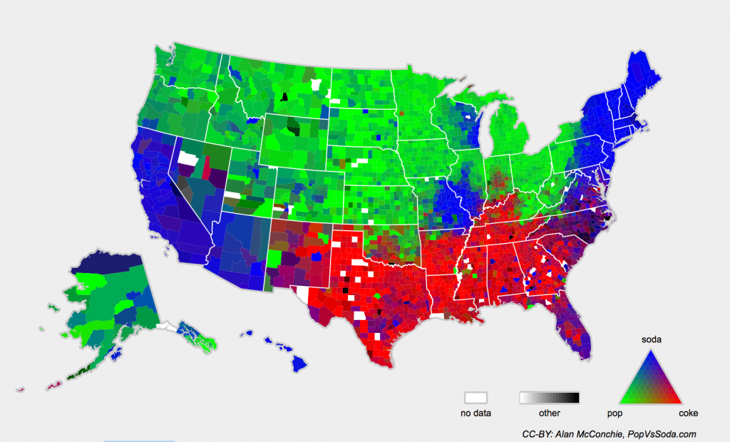
Pop vs. Soda
Notes:
By this point, students should have been exposed to some semblance of research methods, and should be tasked with interpreting the above map.
Ask “What is this map telling us?”
Depending on the class size and format of the room, you may need to describe the key at the very bottom – Green is for “Pop”, Red is for “Coke” and Blue is for “Soda”. White to Black is for “Other”.
Students should identify regions where particular terms for carbonated beverages are more concentrated. It should be stressed that language is a key component of culture, and that it is bound to particular places.
At this point, ask students if they know what Coca-Cola might be called in places which are characterized by “Other”. The most popular terms under “Other” are: Fizzy drink, Fizz, Fizzy-pop, Sodie, Sodie-pop, Sodie water, Soder, and Bubbly.
“Do our own experiences align with the map above?”
Be sure to follow-up this discussion with a take-away: that language, a key component of culture, is again bound to particular places.

Slide 8
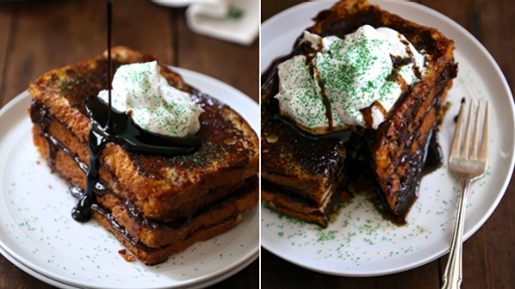
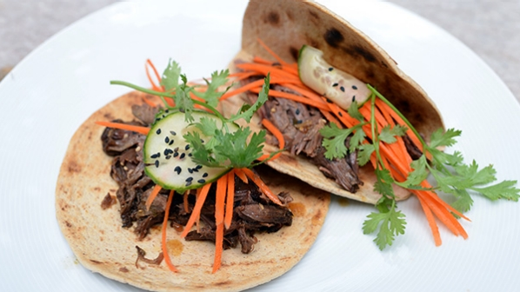
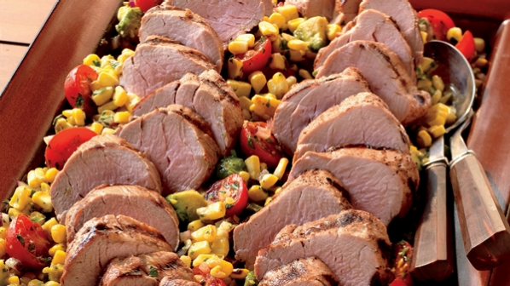
Culture through objects
1. How does the object relate to your personal life?
Notes:
1. Moving away from culture’s anchor in specific places, and toward students’ tangible use in their personal lives, ask the following:
a. “When do you drink Coca-Cola?”
b. The goal of this question is to field the possible range of answers for its consumption. Some students may drink it only as an indulgence, others with every meal, and some only around particular family members.
2. Follow-up with:
a. “Why do they drink it (or don’t)?”
b. This question should get at the role of family, friends, diet, habits, etc. and how they affect why they drink it (or don’t). Many aspects of culture, whether it’s religion, family, region (rural vs. urban areas) influences how we interact with objects. Conclude with something along the lines of: “We can see how this product is used differently because of where we com from. That ultimately influences its presence in our lives. The people we are surrounded by teach us how and why to behave the way we do; this includes teaching us when, how and why we interact with objects.”
3. Continue by asking:
a. “Has anyone used Coca-Cola to cook?”
b. This question may seem rather odd to most students, and so the above three images serve as foundations to consider the use of Coca-Cola, in ways that are not conventional, but still practical. Reveal each image one at a time and, and briefly describe each recipe (as it relates to the use of Coca-Cola).
IMAGES: (Left) Coca-Cola Korean Beef Tacos
(Center) Coca-Cola Marinated Pork Tenderloins
(Right) Chocolate Ganache Stuffed French Toast with Coca-Cola Stout Syrup
Image Sources: http://www.coca-colacompany.com/stories/food/2013/coca-cola-korean-beef-tacos
http://www.coca-colacompany.com/stories/food/2013/new-real-grilling-coca-cola-marinated-pork-tenderloins
http://www.coca-colacompany.com/stories/food/2014/chocolate-ganache-stuffed-french-toast-with-cola-stout-syrup

Slide 9
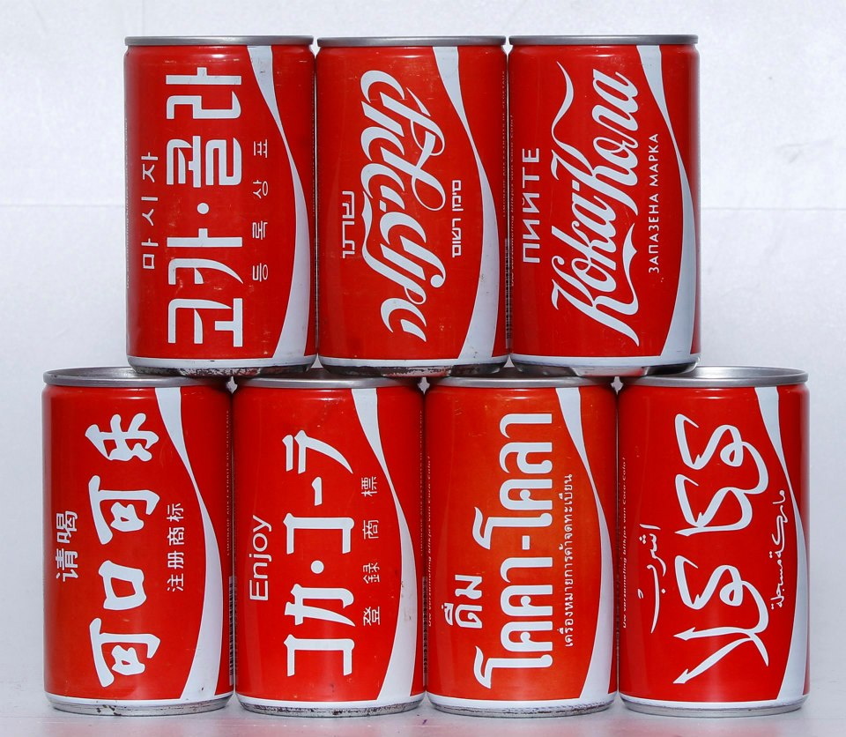
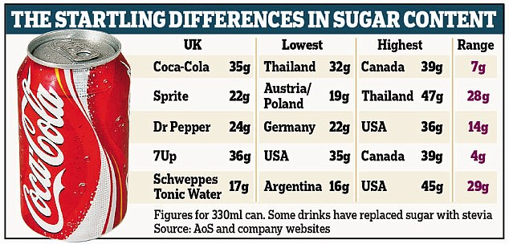
Culture through Objects
1. How is the object bought and sold?
2. Who benefits from it? Who suffers from it?
Notes:
[Reveal First Question]:
a. Ask students: “In what ways do we purchase and sell this object?”
b. Elucidate differences in how the object is Packaged (different sized, shaped, etc. bottles, cans and glasses), and Flavored (Coke-Cherry, Diet Coke, Caffeine Free, etc.). Sugar is also a distinguishing factor in Coca-Cola’s production, and varies by country.
At this point, [Reveal the First Image] to display differences (in language and presentation) between this product in different cultures.
[Reveal the Second Image] If it hasn’t been mentioned already in discussion– “Sugar is also a distinguishing factor in Coca-Cola’s production, and varies by country.” Guide students to notice how widely the amount in the product changes by country, and notice the range for each carbonate beverage.
Ask Students: “Who buys and sells this object?”
Encourage students to distinguish between consumers, and producers. There are, however, multiple levels of both consumers and producers. For example, public schools set up contracts with either Coca-Cola or Pepsi to sell their respective brands. Restaurants and fast-food chains do too. There are also plastic companies, glass companies, etc. who sell the materials and ingredients necessary to construct the final product. This discussion should lead smoothly into the next section which is: Who Benefits from the product?
[Reveal Second Question] “Who benefits from the consumption of Coca-Cola?”
Guide students to look beyond simply the company Coca-Cola itself. This product potentially benefits many groups of people who provide services: plastic companies, schools (who receive commission from kiosks), dentists and doctors, farmers (relate back to the use of sugar), etc.
“Who suffers because of this object?”
a. Lead students to think about consumers who suffer because of tooth decay, obesity, diabetes, etc. Also consider the environmental effects of pollution, and how it might disproportionately affect marginalized populations. This should lead directly into the next slide, which introduces social problems, especially with Indian farmers and the drought accompanied by Coca-Cola’s factory.
Image Sources:
http://www.dailymail.co.uk/health/article-3255034/Coca-Cola-Pepsi-brands-differ-sugar-world.html
https://www.pinterest.com/pin/229894755954252783

Slide 10

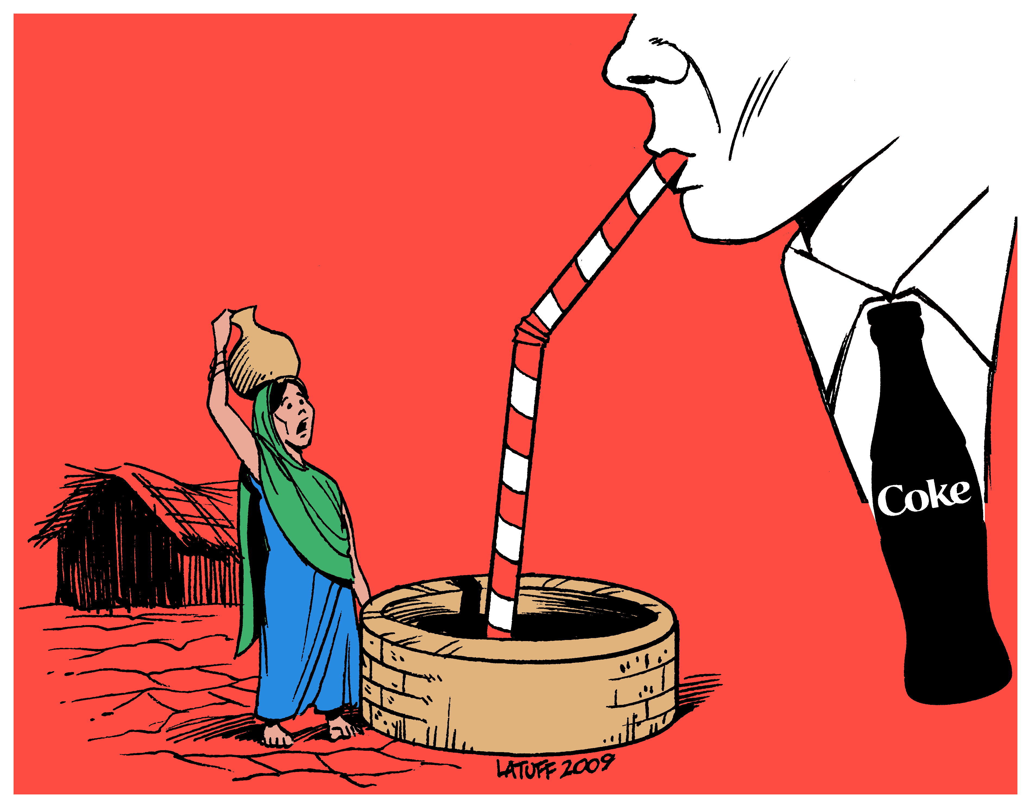
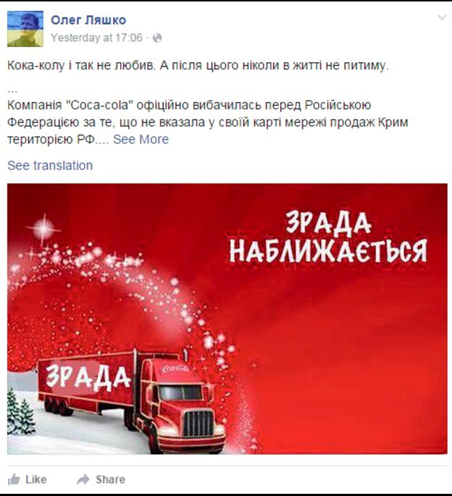
Culture through Objects
What Social Problems surround this cultural object?
Notes:
Ask students the following:
“What Social Problems surround this cultural object?”
Students may present their own knowledge of social problems that surround its production. If that doesn’t happen, [Reveal Right Image] first.
“Does anyone recognize the image? Does anyone know what this image is depicting?” Again, it’s not important if student’s do not recognize the social problem. Quickly go on to describe the issue between Indian Farmers and the Coca-Cola company.
“The image is depicting the conflict between India’s local farmers and the Coca-Cola Company. Farmers in Rajasthan, India were struggling against severe drought, and lower aquifer levels to maintain their crops. The issue revolved around a Coca-Cola factory (Lazaro 2008), which began to quickly decrease the level at which aquifers and local well water replenished. In some interviews conducted by PBS News Hour, one local farmer had the following to say:
“Before [the Coca-Cola factory], the water level was descending by about one foot per year. Now it’s 10 feet every year. We have a 3.5-horsepower motor. We cannot cope. They [Coca-Cola Company] have a 50-horsepower pump.” Officially, the Coca-Cola factory uses nearly 900,000 Liters (237,754 Gallons) of water, to both create the product, and clean machinery and bottles (Lazaro 2016). This issue was covered by PBS in 2008, and nearly 8 years later, the plant was finally closed down amid growing protests and pressure from NGOs to decrease the pressure to survive and cope with the decreasing availability of water (Daigle 2016).
[Reveal Left Image]: “Does anyone know what social problem surrounds this image?” Again, immediately follow-up with a description of the social problem if students don’t respond.
“What should stick-out to you in this image is the bottom, left-most portion of this map [Point to Crimea]. The Coca-Cola company initially published the same map on social media, sans Crimea, and in response to Russian citizens’ outcry, added not only Crimea, but also the Kuril Islands and Kaliningrad (which were previously left out as well). The U.S Embassy in the Ukraine responded by condemning Coca-Cola’s actions and reiterating that the U.S. does not support the “illegal occupation” of Russia in Crimea.” (Makortoff 2016)
“Why does Coca-Cola’s map mean so much politically?”
Guide students to see the connection between shared beliefs, symbols and values, and the company’s seeming acknowledgement of a politically contentious issue.
[Reveal Center Image]: “This image is a Facebook post by a Ukrainian reacting to Coca-Cola’s seeming support of the Russian annexation of Crimea. The Image says on the right: “Betrayal is coming” – with ‘Betrayal’ written alongside the semi. And this is sociologically interesting here, because we can begin to see the transformation of this cultural object- a can/bottle of Coca-Cola – here presented as a cultural symbol of betrayal, and oppression. This transformation reflects another important element of culture – that it is malleable not just in its form, like we’ve discussed with drag at the beginning, or it’s use like in food, or even in how it’s packaged and sold – but that it also changes over time”
Citations:
Daigle, Katy. 2016. “Coke suspends bottling at plant at center of water dispute.” The Seattle Times. Retrieved November 15, 2017 (https://www.seattletimes.com/business/coke-suspends-bottling-at-plant-at-center-of-water-dispute/).
Lazaro, Fred De Sam. 2008. “Indian Farmers, Coca-Cola Vie for Scarce Water Supply.” PBS. Retrieved November 14, 2017 (https://www.pbs.org/newshour/show/indian-farmers-coca-cola-vie-for-scarce-water-supply).
Makortoff, Kalyeena. 2016. “Coca-Cola, Google enter Ukraine-Russia minefield.” CNBC. Retrieved November 15, 2017 (https://www.cnbc.com/2016/01/06/coca-cola-angers-ukraine-russia-over-crimea-map-blunder.html).
Image Sources:
http://killercoke.org/crimes_india.php
http://www.bbc.com/news/world-europe-35245282

Slide 11
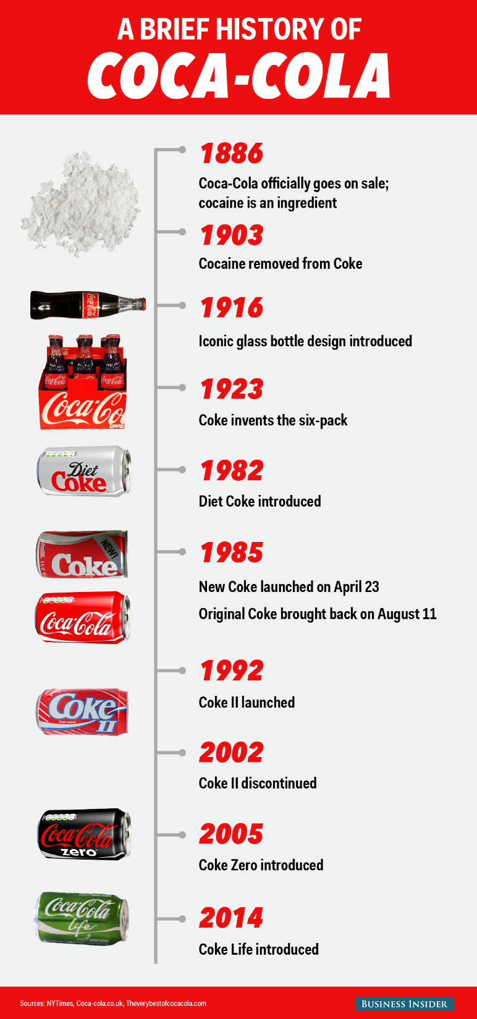
Culture through Objects
What is the history of this object?
What is the future of this object?
Notes:
This slide focuses on exploring how culture changes over time. [Reveal First Question] - Begin by asking students the following:
“Does anyone know anything about the history of Coca-Cola?” Students might bring up the more well-known fact that Coca-Cola once included Cocaine, or that there have been many versions of Coca-Cola (New Coke, which is posthumously called Coke II after a second failed campaign in 1992), or that it was first packaged in glass bottles and not cans or plastic battles. In fact, the first aluminum can was produced in 1960, and the first plastic (PET) bottle was produced in 1978. (Staff 2015) Students should provide a diverse set of responses that you can build on. If not encourage students to think about major industrial changes between the first Coca-Cola drink in 1886, and today. “Were plastic bottles in use in 1886?” or “How were drinks mostly stored in the Early 20th century?” should help you lead students to identify historical changes in its packaging. This should be fairly obvious to students after discussion from Slide 9, about how Coca-Cola is bought and sold.
Describe for students how Coca-Cola did originally contain Cocaine:
“Coca-Cola products did indeed contain cocaine in the original formula. The other main ingredient was actually wine. When cocaine is introduced with wine, the alcohol and cocaine combine in the body to produce cocaethylene, which like cocaine produces euphoria. Interestingly, early marketing efforts depicted Coca-Cola as a “temperance” drink- “a cure for all nervous afflictions.” (Hamblin 2013) It wasn’t until early prohibition efforts that the wine was removed and replaced with sugar syrup. Cocaine as an ingredient did become an issue later, but not simple because of cocaine’s psychoactive effects. This is a passage from an Atlantic article about Coca-Cola:
“…as Grace Elizabeth Hale recounted recently in the The New York Times, Coca-Cola "quickly caught on as an 'intellectual beverage' among well-off whites." But when the company started selling it in bottles in 1899, minorities who couldn't get into the segregated soda fountains suddenly had access to it. Hale explains: Anyone with a nickel, black or white, could now drink the cocaine-infused beverage. Middle-class whites worried that soft drinks were contributing to what they saw as exploding cocaine use among African-Americans. Southern newspapers reported that "negro cocaine fiends" were raping white women, the police powerless to stop them. By 1903, [then-manager of Coca-Cola Asa Griggs] Candler had bowed to white fears (and a wave of anti-narcotics legislation), removing the cocaine and adding more sugar and caffeine.” (Hamblin 2013) It should be clear from the passage that Race also played an important part in the material (by material we really mean, the very real physical) transformation of this cultural object.”
3. [Reveal Image]: Briefly describe what the timeline is illustrating– Coca-Cola’s first sale in 1886, when cocaine was finally removed, etc. You may want to discuss the various changes in marketing campaigns (Coke II, Coke Life, Share a Coke campaign, etc.). The key point again should be emphasized:
“Several components of the same object have changed over time, and they are all grounded in culture- Whether it is temperance movements spurring the removal of wine from the original Coca-Cola recipe, or white-middleclass fears driving the removal of cocaine because of its increasing availability to minority groups, or even technological innovations which allowed Coca-Cola to be sold in plastic bottles and aluminum cans – each change is rooted in cultural values and cultural beliefs that have very real effects on the object we see today.”
4. [Reveal Second Question]:
“What is the future of this object?” If students are not forthcoming with responses, then immediately move on to highlight two important arenas in the future:
Sugar use is an important area of concern. You may want to refer back to Slide 9 (Left Image) to reiterate the high concentration of sugar in a 330mL can. At 35 grams, this already exceeds the World Health Organization’s nutrition guidelines which recommends limiting consumption to 25 grams per day, to avoid heart disease, diabetes, obesity and tooth decay. (WHO 2015) Could the future of Coca-Cola include the removal of sugar from its recipe?
New York state initiated a Sugary Drinks Portion Cap Rule which limited the sale of sugary drink portions to no larger than 16 ounces. This proposal was ultimately rejected by New York’s highest court, but could similar legislation be the way of the future? (Grynbaum 2014)
Citations:
Grynbaum, Michael M. 2014. “New York’s Ban on Big Sodas Is Rejected by Final Court.” The New York Times. Retrieved November 15, 2017 (https://www.nytimes.com/2014/06/27/nyregion/city-loses-final-appeal-on-limiting-sales-of-large-sodas.html).
Hamblin, James. 2013. “Why We Took Cocaine Out of Soda.” The Atlantic. Retrieved November 15, 2017 (https://www.theatlantic.com/health/archive/2013/01/why-we-took-cocaine-out-of-soda/272694/).
Jaslow, Ryan. 2014. “World Health Organization lowers sugar intake recommendations.” CBS News. Retrieved November 15, 2017 (https://www.cbsnews.com/news/world-health-organization-lowers-sugar-intake-recommendations/).
Staff, Journey. 2015. “Contour bottle history.” Contour Bottle History | Coca-Cola GB. Retrieved November 15, 2017 (http://www.coca-cola.co.uk/stories/contour-bottle-history).
WHO. 2015. “WHO guideline : sugar consumption recommendation.” World Health Organization. Retrieved November 15, 2017 (http://www.who.int/mediacentre/news/releases/2015/sugar-guideline/en/).
Image Source:
https://www.pinterest.com/pin/277252920786756272/

Slide 12
The Take-Away
Culture is a complex, and deceivingly obvious concept.
History, environment, context and utility converge in a single cultural object, and affect its form.
Question: What other everyday objects might exist which are just as culturally rich as a can of pop?
Notes:
Close the activity with some concluding remarks:
“[Reveal First Line] Culture is at first glance a deceivingly obvious concept. But by taking some time to focus and reflect on a single object, a coca-cola bottle/can, we’ve discovered that it’s actually a fairly complicated concept. Remember that we started by looking at drag as a sort-of conflation of ideal and real culture, and that we would be pulling the concept down to the real, and everyday. We did this by narrowing our vision to a single object – a coca-cola bottle/can. We explored how in the same language, with the same object, there are different names for it, and that those names are bound to places and regions. We also applied this object to our own lives and discussed how our upbringing, habits, diets, how we’re brought-up to behave, influences how we use an object. There are even some uses which are incredibly practical, but perhaps foreign to us (think here about the three food items I showed you). Then we reflected on the diversity of shape, presentation, the composition of the same coca-cola bottle/can and how those affect very important social problems that exist today. And finally, we’ve recognized that this single everyday object is also something that changes over time. So the Take-Away here, is that the form that cultural objects can take is determined by its particular History, the Place in which it exists (and thereby affects and is affected by its environment), and its Utility. “
Check for Understanding:
The goal here is not to initiate another long discussion of cultural objects and their histories, utilities, etc. Instead, this should serve as a springboard to check that students are transposing the previous concepts to other appropriate objects. Field the following question:
[Reveal Question] “What other everyday objects might exist, which are just as culturally rich as a bottle/can of pop?”

Slide 13
Using the Sociological Imagination
The Sociological Imagination is the “awareness of the relationship between a person’s behavior and experience and the wider culture that shaped the person’s choices and perceptions. It’s a way of seeing our own and other people’s behavior in relationship to history and social structure...” (OpenStax 2e)
Notes:
Reiterate that the Sociological Imagination is a useful framework for viewing the world – We’ve been using it the entire class period!
Expand on something like the following:
“We’ve already introduced the Sociological Imagination as a useful framework for understanding social processes. Consider though that what we’ve done in the previous activity is remain aware of how an object which we see as being rather mundane, and everyday, even obvious, has been deeply shaped by the “wider culture”, and as a result, our experiences with it have also been shaped. What’s more, we’ve also reflected on how the same object has a specific relationship to history, and social structure (by social structure, I mean the powerful and the less powerful, as in India, and also the political power it can carry, as in Russia and Crimea). And now we turn to how we sociologically describe and name culture.”

Slide 14
Elements of Culture
Values: a subjective standard for what is ‘good’, and is embedded in the construction of beliefs.
Beliefs: tenets or convictions that people insist are true, and reaffirm commitments to particular values.
Social Norms: defined behavior that reinforces a society’s values.
  Formal Norms – established and written behaviors
  Informal Norms – behaviors that are generally conformed to
Notes:
The following slides are fairly straightforward and should consistently link these terms back to the class activity that was just completed. This slide and those that follow can be reserved for the next class period if discussion has been rich enough to consume most or all of the current class time.
Students may have heard of ‘value judgements’ before. This is an easy way of conveying what ‘Values’ are, broadly. Value Judgements are often seen as a negative thing, and are often placed in opposition to ‘Objectivity’. In this way, values are subjective standards for what is good. This is certainly a platform for more complicated discussions, but should be constrained to specific standards (e.g. Wealth, self-sufficiency, humility, self-improvement, pride, obligations to others, aesthetics, etc.).
“[Reveal Values] Think back to our discussion of Coca-Cola in India, and how citizens organized protest against the Coca-Cola facility. The factory brought with it many jobs, and a great deal of wealth to the community. It’s evident that the people in Rajasthan valued their connection to the tradition of farming and agriculture, over wealth (and pollution).”
[Reveal Beliefs] Beliefs are built out of commitments to certain values. OpenStax offers the example of the American Dream- that by working hard, you can lift yourself up by your bootstraps to achieve your dreams, and accumulate wealth doing so. This reflects a commitment to individualism, to wealth, and more existentially, determinism – that we are in control and responsible for ourselves.
[Reveal Social Norms] Social Norms sustain values by encouraging particular behaviors and practices. For example, those who work in large office buildings with elevators may value privacy and personal space. As a result, it is normal for people who are waiting in an elevator to limit eye contact, face forward and avoid excessive talking/discussion. Similarly, particular communities may value collective health and attempt to normalize this by passing legislation to limit how sugar is sold (link to New York’s ‘soda ban’ introduced previously).
[Reveal Formal and Informal Norms] Formal and Informal norms are fairly self-explanatory. You can check for student understanding by asking:
“Using the examples I provided earlier (the elevator and soda ban), which would count as a Formal or Informal Norm?”

Slide 15
Culture Defined
Culture is a set of shared beliefs, values and/or practices.
Society describes a community which also shares culture. It is a culture that is bound to a particular place.
Examples: The Valley
The Southwest or Midwest
United States,
Western Culture
Notes:
1. [Reveal Culture] “Culture is the convergence of shared beliefs, values and/or practices. Culture is important to distinguish from Society.
2. [Reveal Society] “Society describes a community which also shares culture. It is a culture that is bound to a particular place.”
[Reveal Examples] Examples: The Valley – It can be as local as a neighborhood.
The Southwest or Midwest – It can be broader to include regions (link back to the pop vs. soda map)
United States – Nationally
Western Culture – Globally
American Sociological Society – It can also encompass groups of professionals, trade associations, or otherwise defined collectives which exhibit culture. “

Slide 16
Culture Defined
Material Culture: the physical objects that belong to groups of people
  Metro/bus passes, architecture, food, automobiles, etc.
Non-Material Culture: ideas, attitudes, values and beliefs of a group of people. Physical objects can symbolize non-material culture.
  The ideas of formal, non-formal (casual), standards for education, accepted social distances (physical) between people, etc.
Notes:
[Reveal Material Culture] Material Culture: the physical objects that belong to groups of people
Metro/bus passes, architecture, food, automobiles, etc.
Emphasize that our exploration of the Coca-Cola bottle/can is an example of material culture, as a physical object.
[Reveal Non-Material Culture] Non-Material Culture: ideas, attitudes, values and beliefs of a group of people. Physical objects can symbolize non-material culture.
a. The ideas of formal, non-formal (casual), standards for education, accepted social distances (physical) between people, etc.
b. Connect the concept of Non-Material culture to the transformation of a Coca-Cola bottle/can to symbolize imperialism/oppression that was discussed on Slide 10.

Slide 17
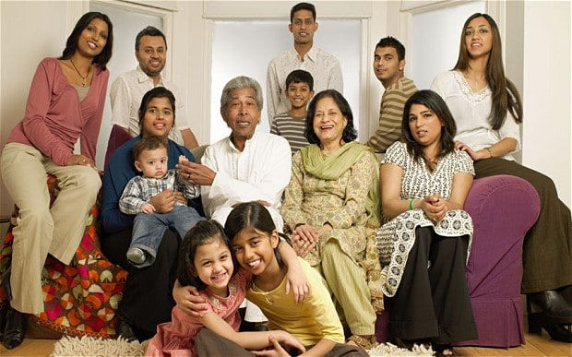
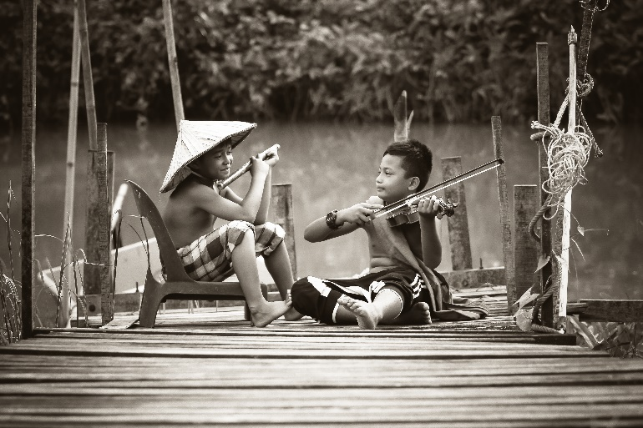
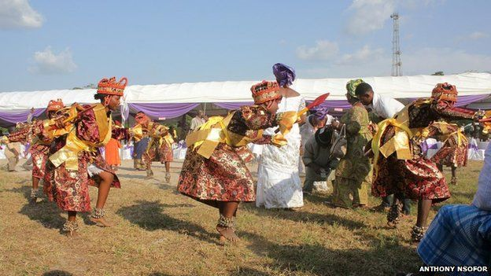
A Common Culture
Cultural Universals: Social attributes and patterns which are common to many, or all societies.
Notes:
[Reveal Cultural Universals] Cultural Universals: Social attributes and patterns which are common to many, or all societies.
“ Some social patterns are present in many or all societies. [Reveal Left Image] One particularly potent example is music. Certain progressions in sound/tone are interpreted by many cultures to indicate specific basic emotional states – Happiness, Sadness, or Fear. [Reveal Center Image] Many cultures also have unique behaviors that recognize death socially. [Reveal Right Image] Many cultures also recognize a family structure. Although that family can look vastly different. For some, it’s the nuclear family, parents and children. For others, it includes extended family members such as grandparents, great grandparents, or cousins, aunts and uncles. Less typical, certain communes recognize a family unit that is comprised of members who are not biologically related. In our discussion of Coca-Cola, what is it about the object itself that might represent a cultural universal?” Encourage students to recognize that the shape of the drink remains fairly consistent, and that it’s commonly used during meals.

Slide 18
Perceiving Culture
Ethnocentrism: the belief and/or attitude that one’s own culture is superior to others.
Cultural Relativism: assessing another culture by its own standards, and limiting an ethnocentric lens.
Notes:
[Reveal Ethnocentrism] Ethnocentrism: the belief and/or attitude that one’s own culture is superior to others.
a. Connect this concept both to the various cultural specifications that Coca-Cola modifies its drink to (e.g. sugar concentration, temperature, size, etc.) and to the debate around Pop vs. Soda (it is itself a debate about what carbonated beverages should be called based on where people are culturally located).
2. [ Reveal Cultural Relativism] Cultural Relativism: assessing another culture by its own standards, and limiting an ethnocentric lens.
b. Connect this concept to our own investigation of Coca-Cola in India:
“An ethnocentric view might be the attitude that the Coca-Cola Company is bringing a great deal of jobs and wealth to the Rajasthan region, and pollution is an acceptable cost to the Indian community. However, this again ignores the cultural values that the Indian community places on the existing tradition of farming and agriculture, and the vitality of their environment.”

Slide 19
Theoretical Frames
Conflict Theory: Cultural norms privilege certain values, ideas, attitudes, spaces and histories.
  How would a social problem related to Coca-Cola be interpreted by a Conflict Theorist?
Symbolic Interactionism: Objects and actions are attached to particular symbolic meanings. Communication and language are key mediums in which objects and actions are interpreted and ultimately, responded to.
  How would meaning attached to Coca-Cola be interpreted by a Symbolic Interactionist?
Notes:
[Reveal Conflict Theory] Conflict Theory: Cultural norms privilege certain values, ideas, attitudes, spaces and histories.
[Reveal First Question] “How might a social problem related to a can of Coca-Cola, be interpreted by a conflict theorist?”
If students do not immediately connect the concepts from class, remind them of the international social problems discussed (e.g. Crimea and Ukraine; India and water).
Link conflict theory to the historical transformation of Coca-Cola to exclude cocaine from its recipe:
“When we looked at the history of Coca-Cola, and why cocaine was removed from the original recipe, the reason for its removal was far from functional. It was deeply social. And beyond that, deeply embedded in Race and the privileging of white-middle class values and beliefs. This shouldn’t suggest that African-Americans had some oppositional stake or interest in keeping cocaine in the recipe. Rather, that power remains deeply embedded in who is able to create and establish social norms. In this case, white fears of ‘negro cocaine fiends raping white women’ and middle-class interests in ‘temperance’ (however ill-defined) were what motivated the re-construction of that everyday object. And so critically, African-Americans’ values, ideas, attitudes, etc., by virtue of this racialized group’s location in the social structure, were de-privileged by existing cultural norms.”
2. [Reveal Symbolic Interactionism] Symbolic Interactionism: Objects and actions are attached to particular symbolic meanings. Communication and language are key mediums in which objects and actions are interpreted and ultimately, responded to.
a. [Reveal Second Question] “How would meaning attached to Coca-Cola be interpreted by a Symbolic Interactionist?”
b. If students are not forthcoming, encourage them to consider the Share-a-Coke advertising scheme, and how that might change the meaning of a Coke in an interaction. How might we explain the Pop vs. Soda map through
b. “How might we explain the Pop vs. Soda map from a Symbolic Interactionist perspective?”
Link symbolic interactionism to Pop vs. Soda.

Slide 20
Using the Sociological Imagination
Guiding Question:
In Nnedi Okorafor’s talk, how does culture influence the construction of her character’s behavior, experience, environment, and future?
https://www.ted.com/talks/nnedi_okorafor_sci_fi_stories_that_imagine_a_future_africa#t-544450
Notes:
Culture Assignment:
1. Introduce a guiding question so that students remain vigilant in thinking about the video as they watch it, and don’t simply sit-back and vegetate:
Guiding Question:
“In Nnedi Okorafor’s talk, how does culture influence the construction of her character’s behavior, experience, environment, and future?”
The link should take you to a TED Talk video which is about 9 minutes long. Give yourself about three more minutes beyond the video’s length to go over assignment details, and provide students the opportunity to ask clarifying questions.

Slide 21
Assignment
What if an element of your own culture (Material or Non-Material) were radically changed by a new technology? How would your life be different?
  Write a fictional story which introduces an answer to the above question
  1-2 Pages in length, Single Spaced, Times New Roman, Size 12 font
  Clearly identify a material or non-material element of culture that is being changed.
  Create a new technology (possible, impossible, or improbable) that transforms the experience of the above element.
  Be creative and have fun with this assignment!
  [LEARNING OBJECTIVES MET:]
Notes:
Reveal first: “What if an element of your own culture (Material or Non-Material) were radically changed by a new technology? How would your life be different?”
Reveal second: Write a fictional story which introduces an answer to the above question
1-2 Pages in length, Single Spaced, Times New Roman, Size 12 font
Reveal third: Clearly identify a material or non-material element of culture that is being changed.
Create a new technology (possible, impossible, or improbable) that changes the above element.
Reveal Fourth: Be creative and have fun with this assignment!
Connect back to syllabus learning objectives: For Example, in my own class - “LEARNING OBJECTIVES MET:
[1] Understand sociological concepts, methodologies, theories and terms.
[6] Apply understandings of sociological concepts through concise descriptions of sociology in action.”

